Slide 1
Java Basics Summary

Slide 2
Variables
name
value
type
int total = 200;

Slide 3
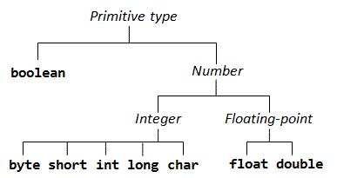
Primitive Types
Primitive types in java
byte, short, int, long
float, double
boolean
char

Slide 4
Primitive Types size
Numeric types are byte, short, long, int, double, float
byte – 8b (-128 : 127)
byte b = 100;
short – 16b (-32768 : 32767 )
short s = 10000;
int – from integer, 32b (-2^31 : 2^31-1)
int i = 10000;
char is used for 16b unicode character
Char values are embedded in ' '
char ch = 'c';
boolean has two values - true or false
boolean bool = false;

Slide 5
Default values
Data type ● byte ● short ● int ● long ● float ● double ● char ● boolean
Default value 0 0 0 0 0.0 0.0 'u\0000' false

Slide 6
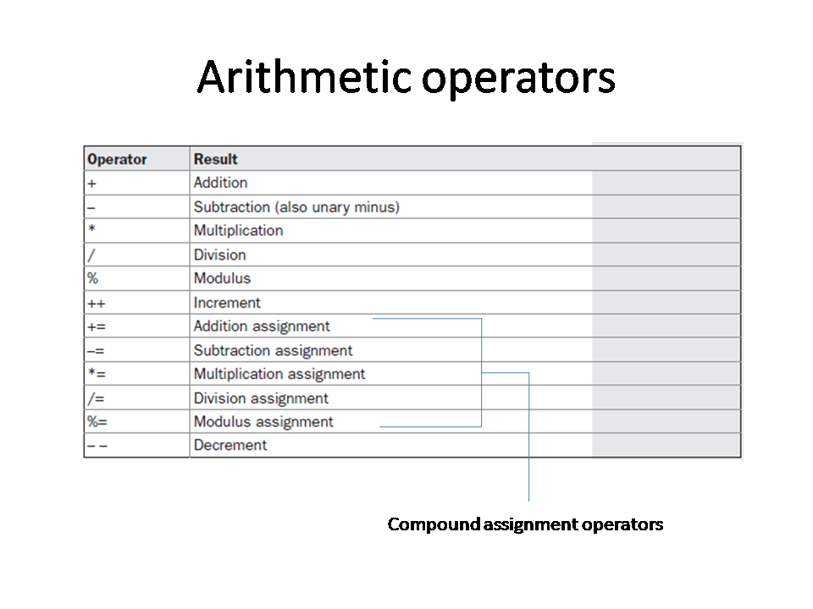

Slide 7
Control Flow
if, else, else if, switch, ?

Slide 8
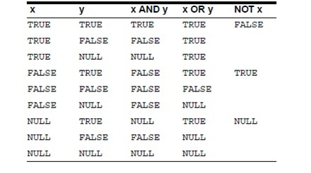
Conditional Statements & Unary Operator
Unary NOT operator !
Conditional AND &&
Conditional OR ||

Slide 9
Arrays

Slide 10
Loops
For, do while, while, *”for each”

Slide 11
Break & Continue

Slide 12
Strings

Slide 13
Object oriented programming
Classes
Fields
Methods
Constructors
Static members
Inheritance
Access modifiers
Interfaces & Abstract classes
Polymorphism
Inner classes, static classes
Upscaling / Downscaling

Slide 14
Exceptions
throwing, catching, writing

Slide 15
Generics

Slide 16
Collections

Slide 17
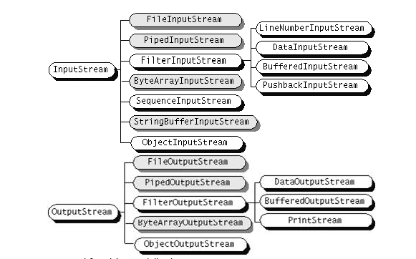
Streams
Binary streams
Text Streams
Files
Serialisation

Slide 18
Swing

Slide 19
Lambdas

